Slide 1
Rust in the Lab
Business Impact Overview
Zach Allen
zacharyja@columbia.com
For internal use only
Notes:
Zach Allen
Presentation on the business impacts Rust will have on Colombia Corporation.
Rust is a programming language focusing on safety and performance.
This is NOT a technical presentation.

Slide 2
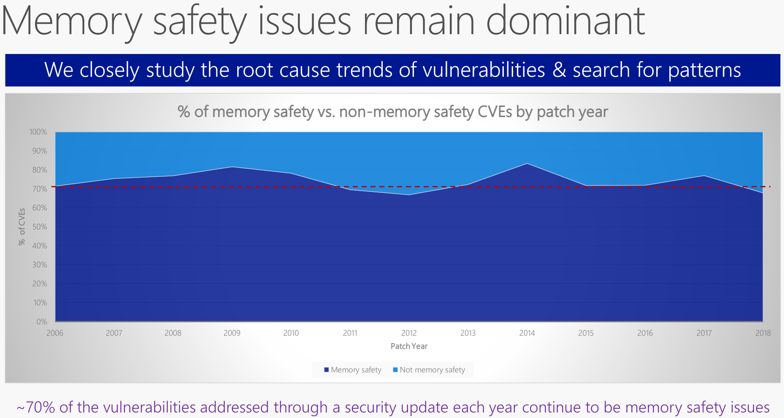
Common Vulnerabilities and Exposures
Miller, M., & Microsoft. (2019, February 6-7). Trends, Challenges, and Strategic Shifts in the Software Vulnerability Mitigation Landscape. YouTube. Retrieved May 10, 2022, from https://www.youtube.com/watch?v=PjbGojjnBZQ
Notes:
The most significant impact of Rust will be on the safety and reliability of our products, and the developer time required for that safety.

Slide 3
Integration & Standardization
Astoria Wants:
Microcontrollers
Network Protocols
Databases
Cloud Services
Web-Native
Control Panels
Dashboards
Analysis Pipelines
Report Generation
Rust Supports:
Microcontrollers
Virtual Machines & Servers
Serverless
WebAssembly
Notes:
Rust will increase the reward for forethought, standardization, and inter-team communication.
The same Rust libraries can be published to all the systems Astoria uses. This reduces the total amount of code to write, and that reduction can be made larger with excellent and intentional library design to meet all future needs, not just the immediate ones.

Slide 4
Ecosystem
Number of Packages:
Cargo: 0,085,000
PyPI: 0,378,400 (4.5x)
NPM: 1,300,000 (15x)
Notes:
Rust’s Ecosystem is young and small, meaning some tasks will fall to our developers, instead of being supported in a library.
It’s possible Columbia Corporation will play a significant role in some open source projects we interact with, and that open source projects will play a significant role in Astoria.

Slide 5
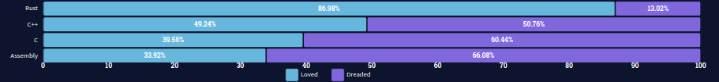
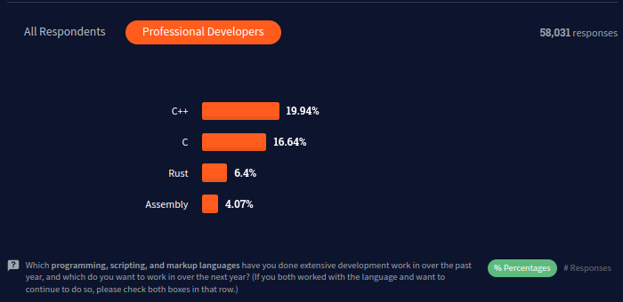
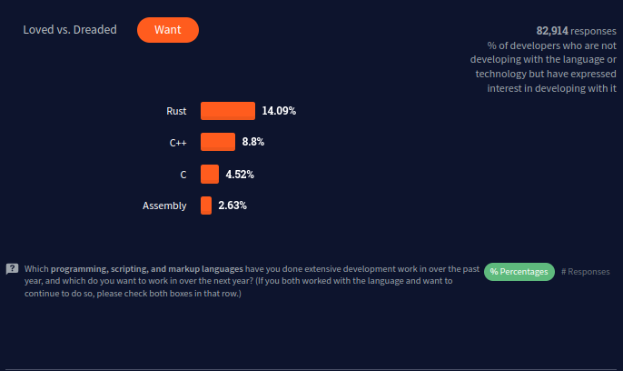
Hiring & Talent
To Developers, Rust is:
Loved
Interesting
Uncommon

